Slide 1
Snapchat Application: A Look into Artistic Neural Style Transfer
By Mehrabi Hasan

Slide 2
Overview and Motivation
Find a way to create snapchat-like filters with Neural Networks
Can be used as a tool for designers and artists
Motivated from stylish

Slide 3
Related Work
“A Neural Algorithm for Artistic Style” - Leon A. Gatys, Alexander S. Ecker, Matthias Bethge
“Perceptual Losses for Real-Time Style Transfer and Super Resolution - Justin Johnson, Alexandre Alahi, Li Fei-Fei
“Arbitrary Style Transfer in Real-Time with Adaptive Instance Normalization - Xun Huang, Serge Belongie
Ayush Chaurasia: Artistic Neural Style Transfer From Scratch on youtube
CodeThisCodeThat: Neural Style Transfer Form Theory to Pytorch
Stepan Ulyanin: Breaking Down Leon Gaty’s Neural Style Transfer in Pytorch.

Slide 4
Questions During Projects
Could Neural Style Transfer create a stylized photo thats similar to a snapchat filter.
Could we find a solution that works well on video
Could we implement this solution on mobile

Slide 5
Terminology and Tools
Content Picture: Picture that we want to get the content of
Style Picture: Photo or artwork that has a distinctive art style that we wish to extract
VGG19: Network Network used by the original Gatsy Paper
Features: Sets of Pixels that can be extracted from an image. Lower Feature Maps extracts simple features and Higher Feature Maps defines more complex patterns.
Pytorch/Tensorflow: A Deep Learning Library that is used to build Neural Networks
Google Colab: A Python Notebook that is ran on Google Cloud Platform and offers a Free Tier of GPU.
We are going to be creating a stylized Image that has features from both the content and style photos.

Slide 6
Content Loss
Image we had a noisy image, and we want to recreate our content image, only knowing the content image weights. We could accomplish this by comparing and changing the pixels within the noisy image and comparing how different they are. If we iterate over this many times, we can successfully recreate something close to our content image. This is the basic idea behind content loss.
We are going to initialize a noisy image
Extract content from noisy image.
We’re going to compute the loss between the content of both the noisy image and content image
This loss is an estimate of how different the current noisy image is different from the content image.
We can optimize our noisy image with back-propogation by computing the gradient with respect to the image pixels (In our training Loop)

Slide 7
Style Loss
Style Loss is similar to Content Loss, but also a little different. Instead of comparing our style image directly, we are going to compare our feature maps itselfs. We’ll do this by calculating the Gram Matrix of each layer activation (usually higher level layers),
We’ll get the style activations from VGG
Then we’ll calculate the Gram Matrix of each feature map of style activations
We’ll then add the weight style loss of each layer together.
Finally we’ll optimize our loss with back-propogation

Slide 8
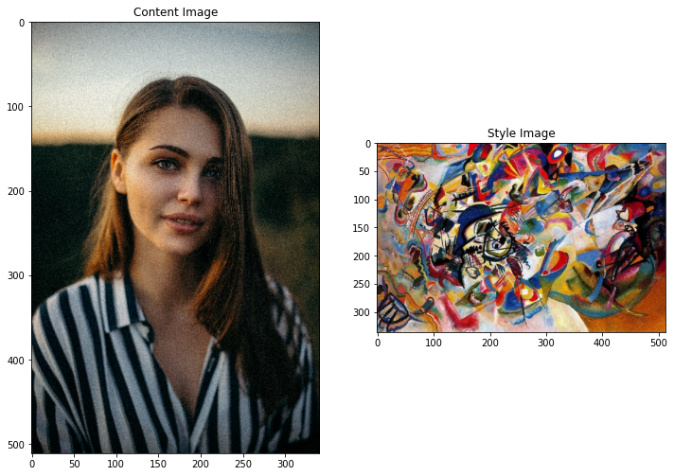
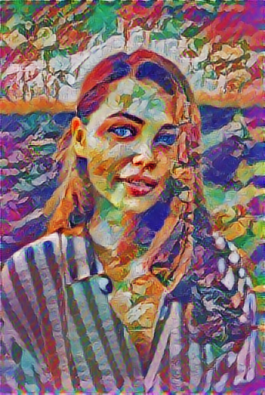
Optimization Loop and Results
We’ll Loop through and calculate our losses.
We’ll optimize along the way, so we can find the best way to minimize this loss.
Update the pixels of our noise image
With a few adjustments in the hyperparameter (Content Weight, Style Weight, Layer Weights, Epochs): You can achieve pretty good results for your training.
Stylized Image

Slide 9
Problems and Future Work
Leon Gatsy’s application was the start to countless applications and projects due to this new idea, however there is a simple flaw in his code. He optimizes the Image after every loop, which turns out to make a stylized photo very slow. Also there is a lot of hyperparameter tuning for the stylized image to be considered “stable”.
There has been some fixes to the problem such as a proposed variational loss that stabilizes the final photo and changing different layers to try stabilize and speed up the network. The current research focuses on Style Transfer for Videos, in Real-Time, and for different simulations.
For my project, I hope to revisit in the future and add a real-time video capture that performs neural style transfer in the cloud. This would allow for a stable video transfer style layout, more similar to how snapchat filters captures an effect, rather than just having a photo stylized for you.

Slide 10
Citation
CodeThisCodeThat: https://www.youtube.com/watch?v=c3kL9yFGUOY
Ayush Chaurasia: https://www.youtube.com/watch?v=K_xBhp1YsrE&t=2s
Stephan Ulyanin: https://towardsdatascience.com/breaking-down-leon-gatys-neural-style-transfer-in-pytorch-faf9f0eb79db
Arbitrary Style Transfer in Real-Time with Adaptive Instance Normalization: https://arxiv.org/abs/1703.06868
Perceptual Losses for Real-Time Style Transfer and Super Resolution: https://arxiv.org/abs/1603.08155
A Neural Algorithm of Artistic Style: https://arxiv.org/abs/1508.06576

